Slide 1
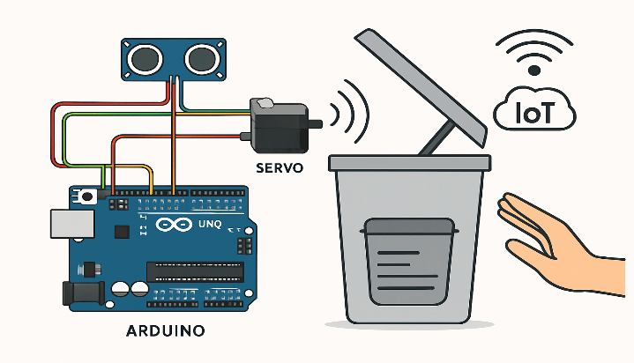

Smart Automated Dustbin

Slide 2
ABSTRACT
The Smart Automated Dustbin project is designed to revolutionize the way waste is managed in both public and private spaces by introducing automation and contactless operation for enhanced hygiene and convenience. At its core, this system uses an Arduino Uno microcontroller interfaced with an ultrasonic sensor to detect the presence of nearby hands or waste materials. When a user approaches, the sensor measures the distance to the object and sends data to the microcontroller, which in turn signals a servo motor to automatically open the bin’s lid. After a short delay, or once the waste is deposited, the lid closes automatically to maintain sanitation and prevent odors from escaping. In addition, smart dustbins can be enhanced with IoT modules such as WiFi or GSM for real-time monitoring and notification when the bin is full, facilitating efficient waste collection by municipal authorities. The system’s hands-free operation drastically reduces the risk of cross-contamination, especially important in sensitive environments like hospitals, schools, and urban areas.

Slide 3
INDEX
S.NO | CONTENTS
1 | INTRODUCTION
2 | OBJECTIVES
3 | METHODOLOGY
4 | RESULTS
5 | CONCLUSION

Slide 4
INTRODUCTION
The Smart Automated Dustbin is a practical innovation addressing contemporary challenges in hygienic waste disposal and urban cleanliness. Traditional dustbins require physical contact, increasing the possibility of spreading germs and creating an unpleasant experience for users. The project aims to transform this interaction by implementing a contactless solution, using embedded electronics to open and close the bin’s lid automatically when a person approaches, thereby significantly enhancing public health and user convenience.
Built around widely available components such as the Arduino Uno, ultrasonic sensor, and servo motor, the system operates in a continuous feedback loop. The ultrasonic sensor, mounted above the bin’s lid, constantly monitors the area in front of the dustbin. As soon as it detects an object—typically a hand or waste—within a preconfigured range, it communicates this information to the microcontroller. The Arduino then processes the input and triggers a servo motor, which lifts the lid to allow waste disposal without human touch. Following a short programmable delay, the lid automatically returns to its closed position, maintaining both hygiene and odor control.

Slide 5
INTRODUCTION
This project exemplifies the integration of microcontroller programming, sensor fusion, and real-time system control, serving as a platform for further development in the fields of automation, Internet of Things (IoT), and smart city solutions. With its adaptability, cost-effectiveness, and positive environmental impact, the smart automated dustbin is a significant advancement toward modern waste management practices.
The automation of mundane activities like waste disposal can have a wide-reaching impact, especially in environments such as hospitals, schools, offices, shopping malls, and smart cities where cleanliness is critical and large numbers of people interact with shared facilities. Furthermore, the smart dustbin can be future-proofed with advanced features—such as real-time fill-level detection using additional sensors, integration with wireless networks to send alerts for garbage collection, or even solar-powered operation to improve sustainability. The system not only introduces users to the fundamentals of embedded programming, sensor integration, and mechanical actuation, but also serves as a gateway into broader applications of IoT and smart infrastructure development.

Slide 6
OBJECTIVES
Hygienic Waste Disposal: To design a system that enables users to dispose of waste without any physical contact, reducing the risk of contamination and promoting cleanliness in shared environments.
Proximity-Based Automation: To utilize an ultrasonic sensor to automatically detect when a user or object approaches, ensuring the dustbin’s lid opens and closes seamlessly and responsively.
Fill Level Monitoring: To measure and track the amount of waste in the bin in real time, providing alerts or notifications when the dustbin is full to prevent overflow and support timely waste collection.
Efficient Waste Management: To facilitate smarter and more efficient waste collection processes, potentially integrating IoT modules for remote monitoring and notifications to municipal authorities or facility managers.

Slide 7
METHODOLOGY
Design and Preparation: The dustbin structure is modified to accommodate the sensors and motor, ensuring stable mounting and smooth lid operation.
Sensor Installation: An ultrasonic sensor is installed near the lid opening to continually measure the distance of approaching objects such as a hand or trash.
Microcontroller Setup: The Arduino (or NodeMCU) is programmed and positioned inside the dustbin, interfacing with all peripherals securely to avoid loose connections.
Power Management: The circuit is powered using a 9V battery or an adapter, with wiring managed to prevent damage and to ensure safety.
Sensor Data Averaging: The microcontroller software averages multiple sensor readings to reduce noise and false triggers, only triggering the lid when a consistent object presence is detected.
Operational Logic: When the sensor detects an object within a set range, the microcontroller activates the servo to open the lid for a pre-defined interval, then closes it automatically—this ensures time-based access control.
Status Indication: An LED or buzzer may be included to indicate the bin's operational status—such as lid opening, closing, or bin full alerts.
Fill-Level Monitoring: An additional ultrasonic or IR sensor measures waste accumulation depth. When a threshold is reached, visual or digital alerts notify users or managers for timely emptying.
System Testing: The complete system is rigorously tested for responsiveness, stability, and robustness, both in laboratory and real-use settings, refining the response timing and sensor thresholds for optimal operation.

Slide 8
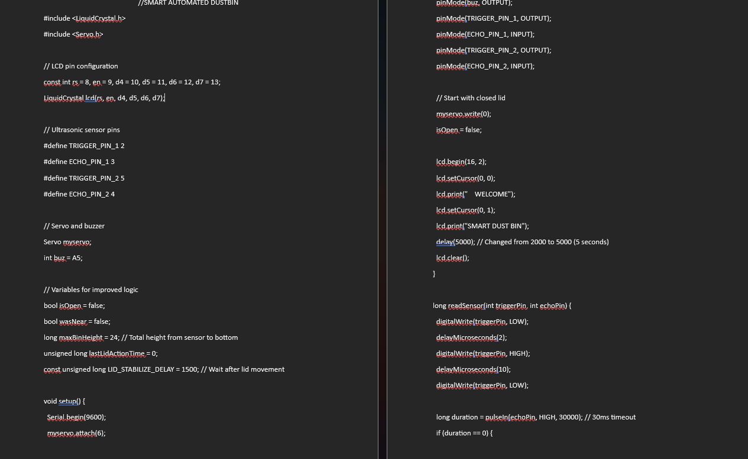

Slide 9
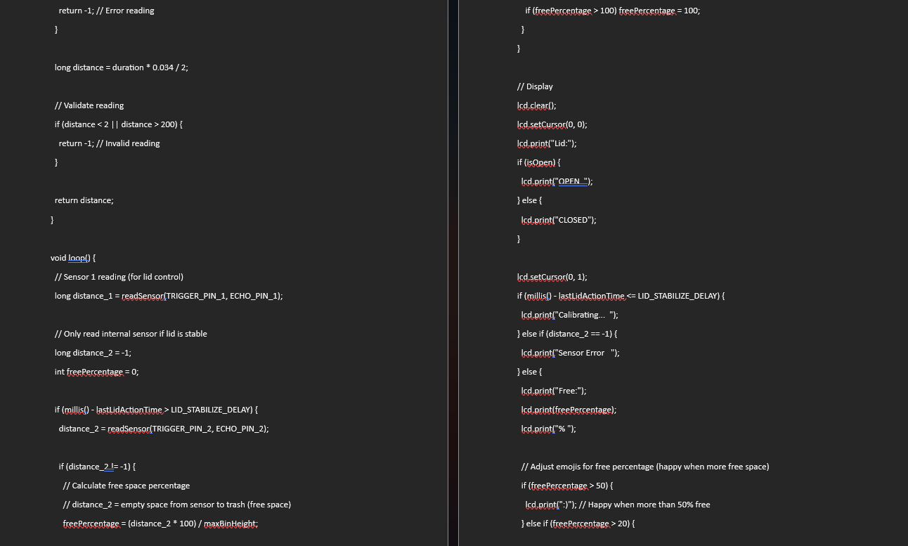

Slide 10
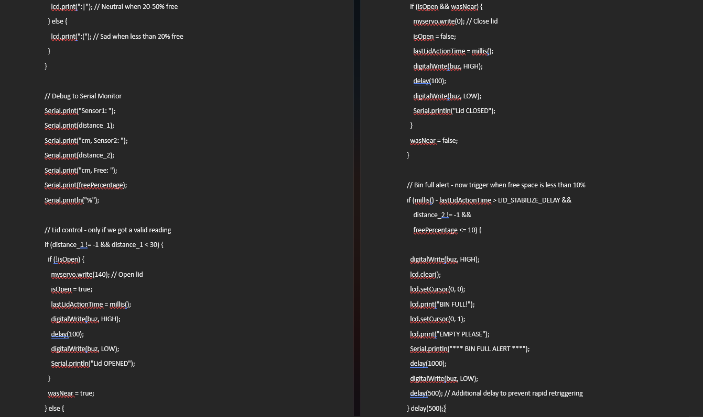

Slide 11
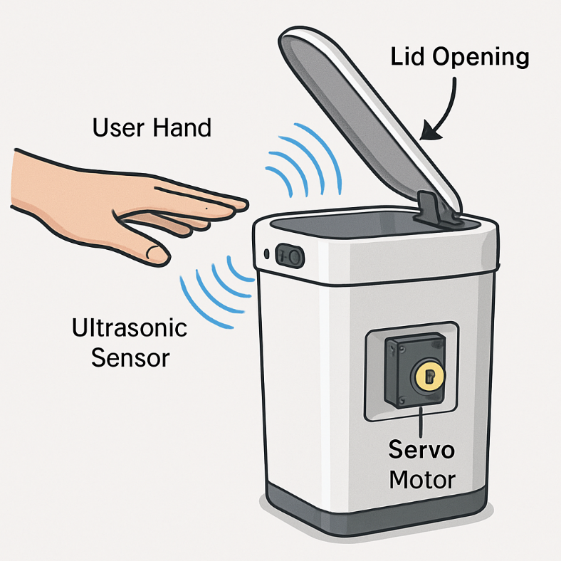

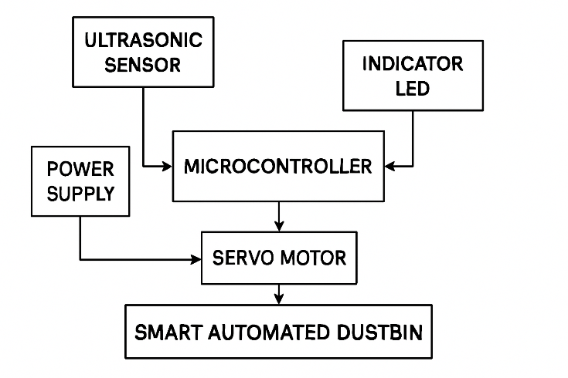
RESULTS
The dustbin achieves efficient, touchless lid operation in under two seconds of user approach, minimizing contact and enhancing user hygiene.
The fill-level monitoring system accurately detects near-full or full status, enabling timely notification and better waste management logistics

Slide 12
CONCLUSION
The Smart Automated Dustbin effectively demonstrates the combination of embedded sensors, microcontrollers, and actuation for hygienic, automated waste disposal. Its hands-free operation and real-time waste level monitoring solve key challenges of manual bins, delivering practical results in both small- and large-scale environments. The project proves that simple automation can significantly reduce health risks and optimize routine waste management tasks.
FUTURE SCOPE
Odor Control: Integration of odor management technologies to further improve user experience and reduce environmental impact.
IoT Remote Monitoring: Adding wireless data capabilities (e.g., WiFi or GSM) for remote status reporting to waste collection services.
Basic Waste Segregation: Simple sorting mechanisms to separate recyclable from non-recyclable items.

Slide 13
Thank You

